Slide 1
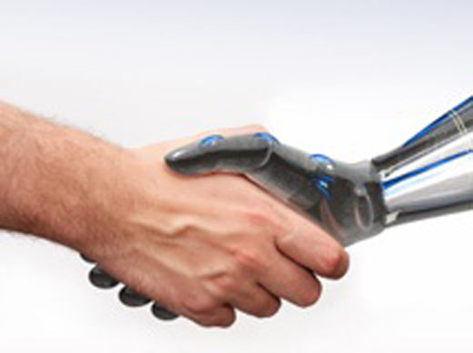
Richer Human-Machine Communication in Attributes-based Visual Recognition
Devi Parikh
TTIC

Slide 2
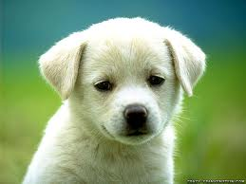
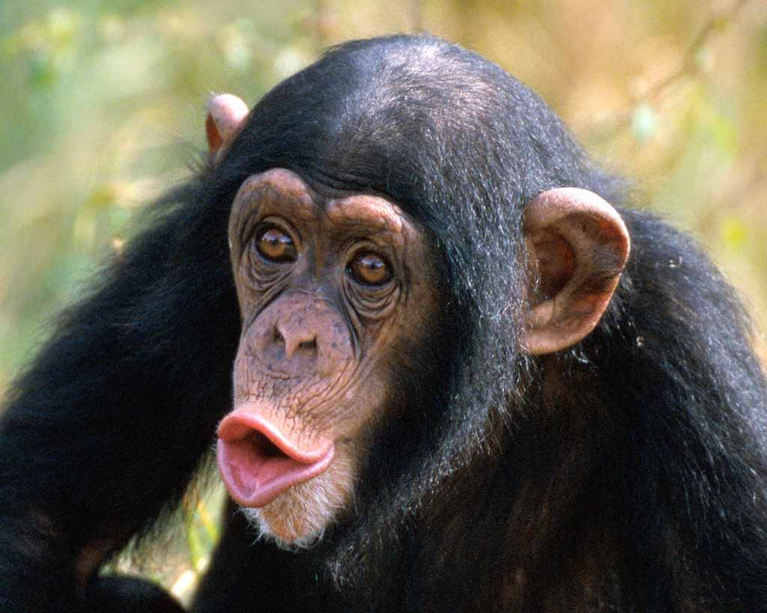
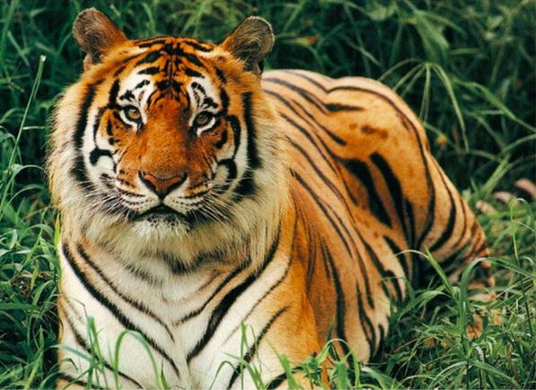
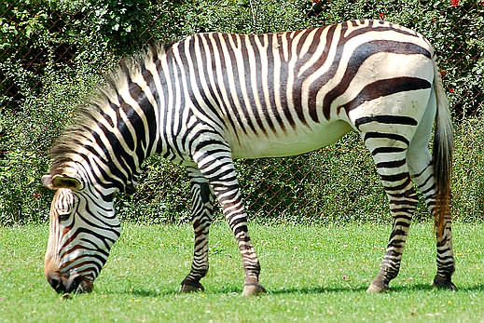
Traditional Recognition
Dog
Chimpanzee
Tiger
???

Slide 3
Attributes-based Recognition
Furry
White
Black
Big
Stripped
Yellow
Stripped
Black
White
Big
Dog
Chimpanzee
Tiger

Slide 4
Applications
Zero-shot learning
Attributes provide a mode of communication between humans and machines!
A Zebra is…
White
Black
Stripped
Zebra
Image description
Stripped
Black
White
Big

Slide 5
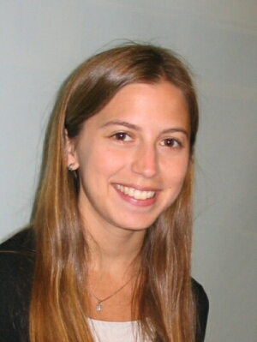
Agenda
Enriching the mode of communication
Nameable and Discriminative Attributes
(to appear CVPR 2011)
Relative Attributes
(under review)
Kristen Grauman

Slide 6
Attributes
Attributes are most useful if they are
Discriminative
Nameable
Approaches | Discriminative | Nameable

Slide 7
Attributes
Attributes are most useful if they are
Discriminative
Nameable
Approaches | Discriminative | Nameable
Hand-generated | Maybe not | Yes

Slide 8
Attributes
Attributes are most useful if they are
Discriminative
Nameable
Approaches | Discriminative | Nameable
Hand-generated | Maybe not | Yes
Mining the web | Maybe not | Yes

Slide 9
Attributes
Attributes are most useful if they are
Discriminative
Nameable
Approaches | Discriminative | Nameable
Hand-generated | Maybe not | Yes
Mining the web | Maybe not | Yes
Automatic splits | Yes | Maybe not

Slide 10
Attributes
Attributes are most useful if they are
Discriminative
Nameable
Approaches | Discriminative | Nameable
Hand-generated | Maybe not | Yes
Mining the web | Maybe not | Yes
Automatic splits | Yes | Maybe not
Proposed | Yes | Yes

Slide 11
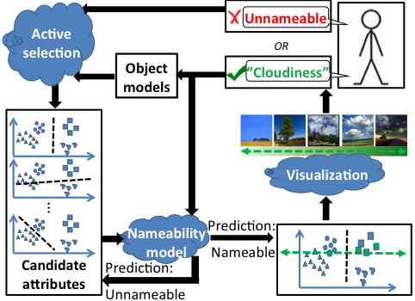
Interactive system
1. Name: Fluffy
2. Name: x
3. Name: Metal
…
How do we show the user a candidate-attribute?
How do we ensure proposals are discriminative?
How do we ensure proposals are nameable?

Slide 12
Attribute visualization

Slide 13
Attribute Visualization

Slide 14
Ensure Discriminability
Normalized cuts
Max Margin Clustering

Slide 15
Ensure Nameability
1. Name: Fluffy
2. Name: x
3. Name: Metal
…

Slide 16
Ensure Nameability
1. Name: Fluffy
2. Name: x
3. Name: Metal
…
Mixture of Probabilistic PCA

Slide 17
Interactive System

Slide 18
Evaluation
Outdoor Scenes
Animals with Attributes
Public Figures Face
Gist and Color features (LDA)

Slide 19
Interactive System

Slide 20

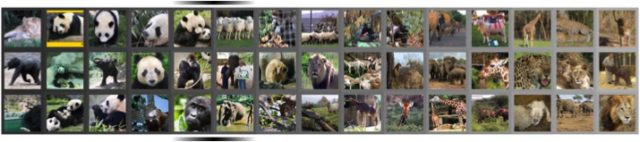
Evaluation
Annotate all candidates off-line
“Black”
… ~25000 responses

Slide 21
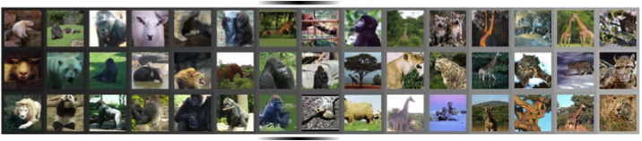
Evaluation
Annotate all candidates off-line
“Spotted”
… ~25000 responses

Slide 22
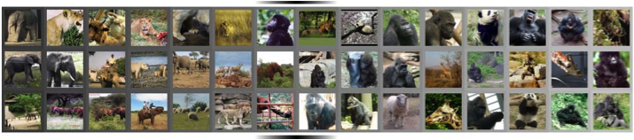
Evaluation
Annotate all candidates off-line
Unnameable
… ~25000 responses

Slide 23
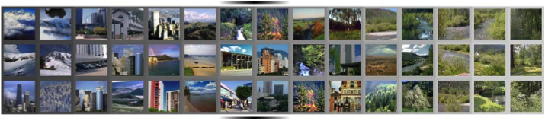
Evaluation
Annotate all candidates off-line
“Green”
… ~25000 responses

Slide 24
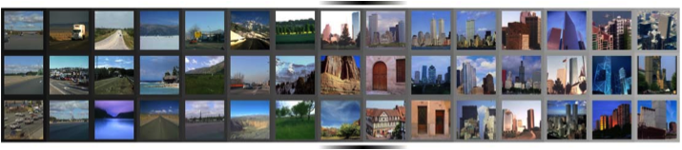
Evaluation
Annotate all candidates off-line
“Congested”
… ~25000 responses

Slide 25
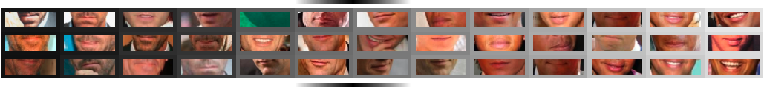
Evaluation
Annotate all candidates off-line
“Smiling”
… ~25000 responses

Slide 26
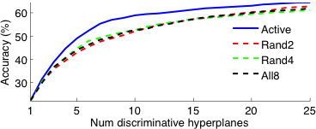
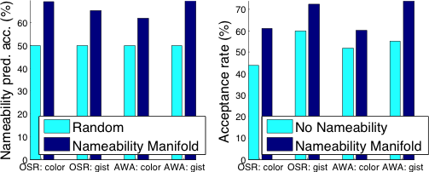
Results
Our active approach discovers more discriminative splits than baselines
Structure exists in nameability space allowing for prediction

Slide 27
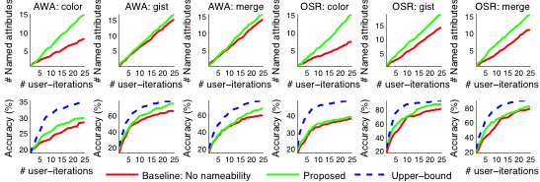
Results
Comparing to discriminative-only baseline

Slide 28
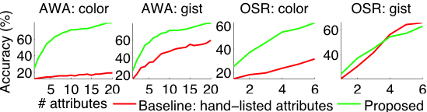
Results
Comparing to descriptive-only baseline

Slide 29
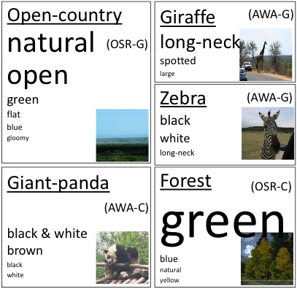
Results
Automatically generated descriptions

Slide 30
Summary
Machines need to understand us
Attributes need to be detectable & discriminative
We need to understand machines
Attributes need to be nameable
Interactive system for discovering attributes
Relative Attributes
More precise communication
Helps machines (zero-shot learning)
Helps humans (image descriptions)

Slide 31
Relative Attributes

Slide 32
Summary
Machines need to understand us
Attributes need to be detectable & discriminative
We need to understand machines
Attributes need to be nameable
Interactive system for discovering attributes
Relative Attributes
More precise communication
Helps machines (zero-shot learning)
Helps humans (image descriptions)

Slide 33
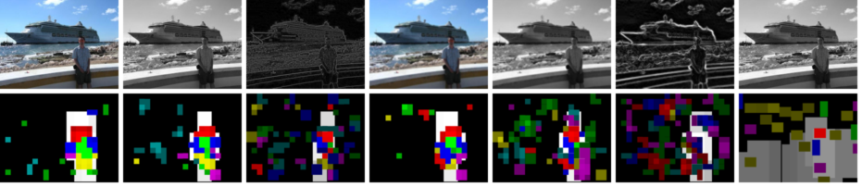
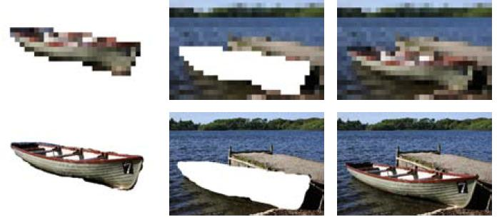
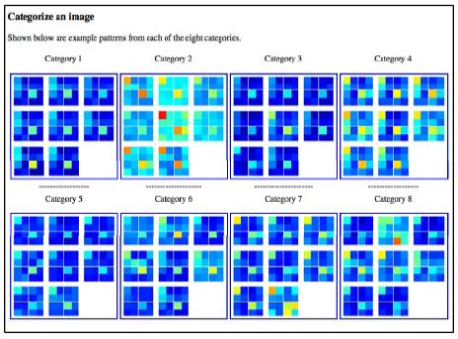

Human-Debugging
Larry Zitnick
(CVPR 2008, 2010, 2011, under review, in progress)

Slide 34
Thank you.

